Slide 1

C♯ Data Access and Entity Framework Core
Rasmus Lystrøm
Associate Professor
ITU
This Photo by Unknown Author is licensed under CC BY-NC

Slide 2
Agenda
Databases (SQL Server)
Old school SQL
SQL Injection
Secrets
The IDisposable interface
Entity Framework Core
Clean Onions
Lazy vs. Eager Loading

Slide 3
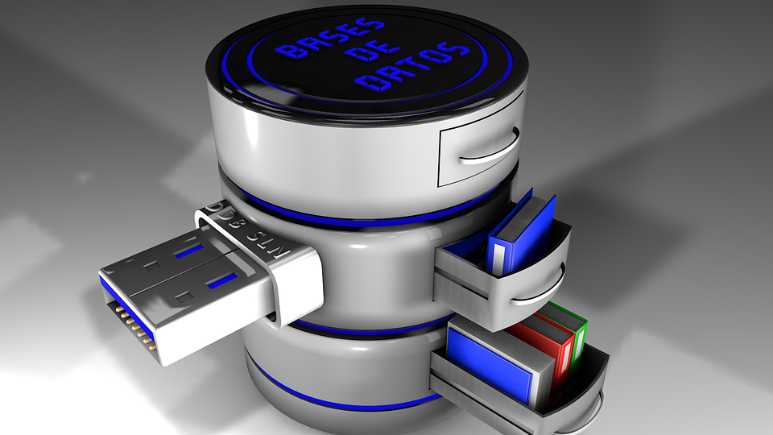
Databases

Slide 4


Databases
Microsoft SQL Server
Oracle Database
IBM Db2
MySQL
MariaDB
PostgreSQL
SQLite
Azure Cosmos DB
Amazon DynamoDB
MongoDB
Couchbase
Redis
Elasticsearch
Neo4j
This Photo by Unknown Author is licensed under CC BY-SA-NC
This Photo by Unknown Author is licensed under CC BY-SA

Slide 5
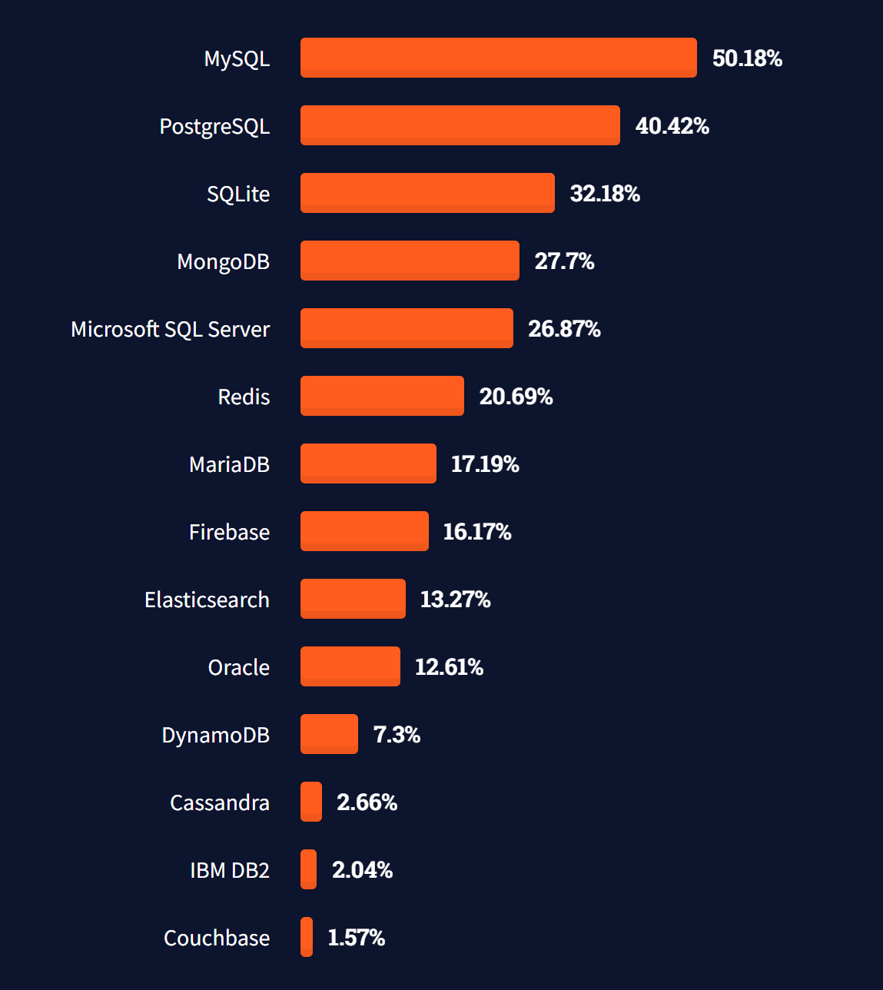
Most popular databases
https://insights.stackoverflow.com/survey/2021#technology-most-popular-technologies

Slide 6
SQL Server
docker pull mcr.microsoft.com/mssql/server:2019-latest
$password = New-Guid
docker run -e "ACCEPT_EULA=Y" -e "SA_PASSWORD=$password" `
-p 1433:1433 `
-d mcr.microsoft.com/mssql/server:2019-latest

Slide 7
SQL Server Demo
SQL Server Docker Container

Slide 8
Old School SQL
dotnet add package System.Data.SqlClient
var cmdText = "SELECT * FROM Animals";
using var connection = new SqlConnection(connectionString);
connection.Open();
using var command = new SqlCommand(cmdText, connection);
using var reader = command.ExecuteReader();
while (reader.Read())
{
...
}

Slide 9
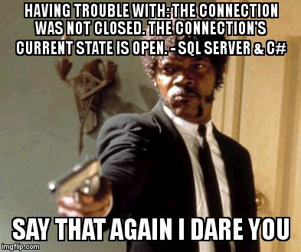
https://twitter.com/overflow_meme/status/1223835574848630784

Slide 10
IDisposable

Slide 11
IDisposable
var resource = new Resource();
try
{
...
}
finally
{
if (resource != null)
{
resource.Dispose();
}
}

Slide 12
IDisposable II
var resource = new Resource();
try
{
...
}
finally
{
resource?.Dispose();
}

Slide 13
IDisposable III
using (var resource = new Resource())
{
...
}

Slide 14
IDisposable IV
using var resource = new Resource();
...

Slide 15
SQL Injection

Slide 16
SQL Injection
A SQL injection attack consists of insertion or “injection” of a SQL query via the input data from the client to the application.
A successful SQL injection exploit can:
read sensitive data from the database,
modify database data (Insert/Update/Delete),
execute administration operations on the database (such as shutdown the DBMS),
or worse
https://owasp.org/www-community/attacks/SQL_Injection

Slide 17

Secrets

Slide 18
Secrets
dotnet user-secrets init
dotnet user-secrets set "ConnectionStrings:ConnectionString" "..."
dotnet add package Microsoft.Extensions.Configuration.UserSecrets

Slide 19
Secrets
using Microsoft.Extensions.Configuration;
...
var configuration = new ConfigurationBuilder()
.AddUserSecrets<Program>()
.Build();
var connectionString = configuration.GetConnectionString("ConnectionString");

Slide 20
Entity Framework Core

Slide 21
Model
Character
Id : int
GivenName : string (50)
Surname : string (50)
AlterEgo : string (50)
FirstAppearance : Date
Occupation : string (50)
CityId : int
Gender : enum
City
Id : int
Name : string (50)
0..1
1
∞
Power
Id : int
Name : string (50)
∞

Slide 22
Entity Framework Core
dotnet tool install --global dotnet-ef
dotnet add package Microsoft.EntityFrameworkCore.Design
dotnet ef migrations add InitialCreate
dotnet ef database update
https://docs.microsoft.com/en-us/ef/core/miscellaneous/cli/dotnet
https://docs.microsoft.com/en-us/ef/core/modeling/

Slide 23

Onion Architecture

Slide 24
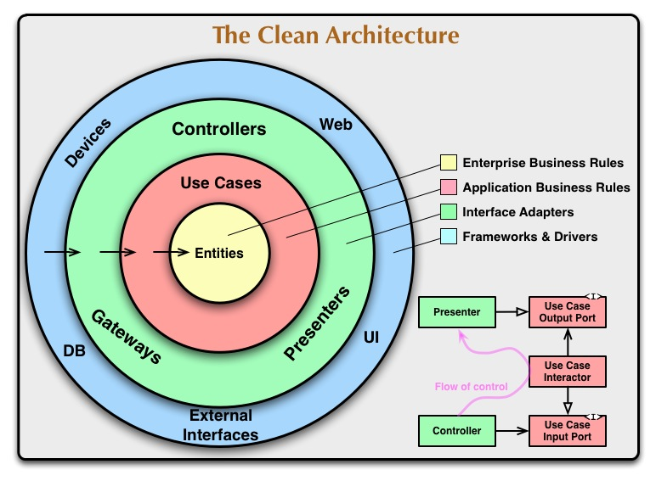

Slide 25
Lazy Loading
https://docs.microsoft.com/en-us/ef/core/querying/related-data/lazy

Slide 26
Lazy Loading
dotnet add package Microsoft.EntityFrameworkCore.Proxies
protected override void OnConfiguring(DbContextOptionsBuilder optionsBuilder)
=> optionsBuilder.UseLazyLoadingProxies()
.UseSqlServer(...);
https://docs.microsoft.com/en-us/ef/core/querying/related-data/

Slide 27

Thank you
This Photo by Unknown Author is licensed under CC BY-NC-ND

